Slide 1
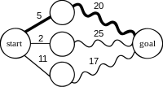
Dynamic Programming
Matrix Chain Multiplication

Slide 2
Dynamic Programming
Introduction
Drawback of Recursion
Elements of Dynamic Programming
Matrix Chain Multiplication

Slide 3
Dynamic Programming
Like divide and conquer, DP solves problems by combining solutions from subproblems.
Unlike divide and conquer, subproblems are not independent.
DP reduces computation by
Solving subproblems in a bottom-up fashion.
Storing solution to a subproblem the first time it is solved.
Looking up the solution when subproblem is encountered again.
Examples
Matrix Multiplication
Longest Common Subsequence

Slide 4
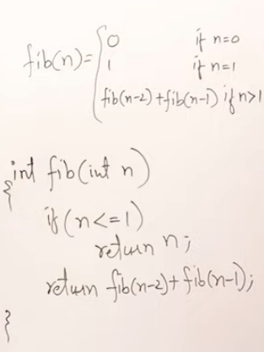
Drawbacks of Recursion: Recursion Tree for n^{th} Fibonacci Term
Complexity:
Solution:1(Memoization)
Complexity:
Top Down Approach
O(2^{n})
Fib(5)
Fib(3)
+
Fib(4)
Fib(1)
+
Fib(2)
Fib(2)
+
Fib(3)
Fib(0)
+
Fib(1)
Fib(0)
+
Fib(1)
Fib(1)
+
Fib(2)
Fib(0)
+
Fib(1)
O(n)
Fib(0) | Fib(1) | Fib(2) | Fib(3) | Fib(4) | Fib(5)
0 | 1 | 1 | 2 | 3 | 5

Slide 5
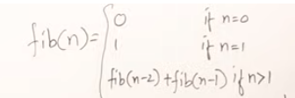
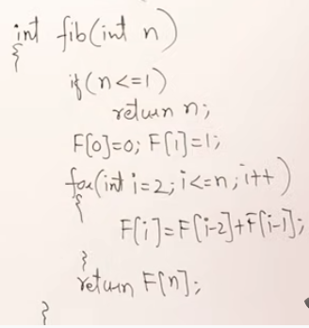
Soultion2:
Dynamic Programming Approach
Tabulation Method
Bottom-up Approach
F (0) | F(1) | F(2) | F(3) | F(4) | F(5)
0 | 1 | 1 | 2 | 3 | 5

Slide 6
Steps in Dynamic Programming
Characterize structure of an optimal solution.
Define value of optimal solution recursively.
Compute optimal solution in a bottom-up fashion
Construct an optimal solution from computed values.

Slide 7
Matrix Chain Multiplication
Given : a chain of matrices {A₁,A₂,…,A_{n}}.
Once all pairs of matrices are parenthesized, they can be multiplied by using the standard algorithm as a sub-routine.
A product of matrices is fully parenthesized if it is either a single matrix or the product of two fully parenthesized matrix products, surrounded by parentheses. [Note: since matrix multiplication is associative, all parenthesizations yield the same product.]

Slide 8
Matrix-chain Multiplication …contd
Example: consider the chain A₁, A₂, A₃, A₄ of 4 matrices
Let us compute the product A₁A₂A₃A₄
There are 5 possible ways:
(A₁(A₂(A₃A₄)))
(A₁((A₂A₃)A₄))
((A₁A₂)(A₃A₄))
((A₁(A₂A₃))A₄)
(((A₁A₂)A₃)A₄)
The way the chain is parenthesized can have a dramatic impact on the cost of evaluating the product.

Slide 9
Matrix-chain Multiplication …contd
Example: Consider three matrices A_{10×100}, B_{100×5}, and C_{5×50}
There are 2 ways to parenthesize
((AB)C) = D_{10×5} · C_{5×50}
AB ⇒ 10·100·5=5,000 scalar multiplications
DC ⇒ 10·5·50 =2,500 scalar multiplications
(A(BC)) = A_{10×100} · E_{100×50}
BC ⇒ 100·5·50=25,000 scalar multiplications
AE ⇒ 10·100·50 =50,000 scalar multiplications
Total: 7,500
Total: 75,000

Slide 10
Matrix-chain Multiplication …contd
Matrix-chain multiplication problem
Given a chain A₁, A₂, …, A_{n} of n matrices, where for i=1, 2, …, n, matrix A_{i} has dimension p_{i-1}×p_{i}
Parenthesize the product A₁A₂…A_{n} such that the total number of scalar multiplications is minimized
Brute force method of exhaustive search takes time exponential in n
eg:-
A₁(5x4), A₂(4x6), A₃(6x2)₎, A₄ (2x7)
A₁(p₀xp₁), A₂(p₁xp₂), A₃(p₂xp₃)₎, A₄ (p₃xp₄)

Slide 11
Dynamic Programming Approach
The structure of an optimal solution
Let us use the notation A_{i..j} for the matrix that results from the product A_{i} A_{i+1} … A_{j}
An optimal parenthesization of the product A₁A₂…A_{n} splits the product between A_{k} and A_{k+1} for some integer k where1 ≤ k < n
First compute matrices A_{1..k} and A_{k+1..n} ; then multiply them to get the final matrix A_{1..n}
A₁(5x4), A₂(4x6), A₃(6x2)₎, A₄ (2x7)
A₁(p₀xp₁), A₂(p₁xp₂), A₃(p₂xp₃)₎, A₄ (p₃xp₄)

Slide 12
Dynamic Programming Approach …contd
Recursive definition of the value of an optimal solution
Let m[i, j] be the minimum number of scalar multiplications necessary to compute A_{i..j}
Minimum cost to compute A_{1..n} is m[1, n]
Suppose the optimal parenthesization of A_{i..j} splits the product between A_{k} and A_{k+1} for some integer k where i ≤ k < j

Slide 13
Dynamic Programming Approach …contd
A_{i..j} = (A_{i} A_{i+1}…A_{k})·(A_{k+1}A_{k+2}…A_{j})= A_{i..k} · A_{k+1..j}
Cost of computing A_{i..j} = cost of computing A_{i..k} + cost of computing A_{k+1..j} + cost of multiplying A_{i..k} and A_{k+1..j}
Cost of multiplying A_{i..k} and A_{k+1..j} is p_{i-1}p_{k} p_{j}
m[i, j ] = m[i, k] + m[k+1, j ] + p_{i-1}p_{k} p_{j} for i ≤ k < j
m[i, i ] = 0 for i=1,2,…,n
A₁(5x4), A₂(4x6), A₃(6x2)₎, A₄ (2x7)
A₁(p₀xp₁), A₂(p₁xp₂), A₃(p₂xp₃)₎, A₄ (p₃xp₄)

Slide 14
Dynamic Programming Approach …contd
0 if i=j
m[i, j ] =
min {m[i, k] + m[k+1, j ] + p_{i-1}p_{k} p_{j} } if i<j
i ≤ k< j

Slide 15
Dynamic Programming Approach …contd
To keep track of how to construct an optimal solution, we use a table s
s[i, j ] = value of k at which A_{i} A_{i+1} … A_{j} is split for optimal parenthesization
Algorithm:
First computes costs for chains of length l=1
Then for chains of length l=2,3, … and so on
Computes the optimal cost bottom-up

Slide 16
A₁(5x4), A₂(4x6), A₃(6x2)₎, A₄ (2x7)
0
 | 0
 |  | 0
 |  |  | 0
A₁(p₀xp₁), A₂(p₁xp₂), A₃(p₂xp₃)₎, A₄ (p₃xp₄)
Chain of length 1
M[1,1]=M[2,2]=M[3,3]=M[4,4]=0
0 | 120
 | 0 | 48
 |  | 0 | 84
 |  |  | 0
Chain of length 2
M[1,2]=5x4x6=120
M[2,3]=4x6x2=48
M[3,4]=6x2x7=84
 | 1
 |  | 2
 |  |  | 3
Split Matrix S

Slide 17
A₁(5x4), A₂(4x6), A₃(6x2)₎, A₄ (2x7)
A₁(p₀xp₁), A₂(p₁xp₂), A₃(p₂xp₃)₎, A₄ (p₃xp₄)
Chain of length 3
M[1,3]
Case:I
M[1,1]+M[2,3]
=0+48+(5x4x2)
=88
Case:2
M[1,2]+M[3,3]
=120+0+(5x6x2)
=180
M[2,4]
Case:I
M[2,2]+M[3,4]
=0+84+(4x6x7)
=252
Case:2
M[2,3]+M[4,4]
=48+0+(4x2x7)
=104
0 | 120
 | 0 | 48
 |  | 0 | 84
 |  |  | 0
0 | 120 | 88
 | 0 | 48 | 104
 |  | 0 | 84
 |  |  | 0
 | 1 | 1
 |  | 2 | 3
 |  |  | 3

Slide 18
Chain of length 4
M[1,4]
Case:I
M[1,1]+M[2,4]
=0+104+(5x4x7)
=244
Case:2
M[1,2]+M[3,4]
=120+84+(5x6x7)
=414
Case:3
M[1,3]+M[4,4]
=88+0+(5x2x7)
=158
0 | 120 | 88 | 158
 | 0 | 48 | 104
 |  | 0 | 84
 |  |  | 0
 | 1 | 1 | 3
 |  | 2 | 3
 |  |  | 3

Slide 19
Algorithm to Compute Optimal Cost
Input: Array p[0…n] containing matrix dimensions and n
Result: Minimum-cost table m and split table s
MATRIX-CHAIN-ORDER(p[ ], n)
for i ← 1 to n
m[i, i] ← 0
for l ← 2 to n
for i ← 1 to n-l+1
j ← i+l-1
m[i, j] ← ∞
for k ← i to j-1
q ← m[i, k] + m[k+1, j] + p[i-1] p[k] p[j]
if q < m[i, j]
m[i, j] ← q
s[i, j] ← k
return m and s
Takes O(n³) time
Requires O(n²) space

Slide 20
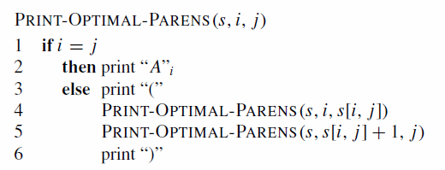
Constructing Optimal Solution
Our algorithm computes the minimum-cost table m and the split table s
The optimal solution can be constructed from the split table s
Each entry s[i, j ]=k shows where to split the product A_{i} A_{i+1} … A_{j} for the minimum cost

Slide 21
Split Matrix S
 | 1 | 1 | 3
 |  | 2 | 3
 |  |  | 3
(
[1,4]
)
(
[1,3]
)
[4,4]
A₄
[1,1]
(
[2,3]
)
A₁
[2,2]
[3,3]
A₂
A₃
A₁ A A₁ ₁
)
)
)
A₄
(
(
(
A₂
A₃
A₁

